Slide 1



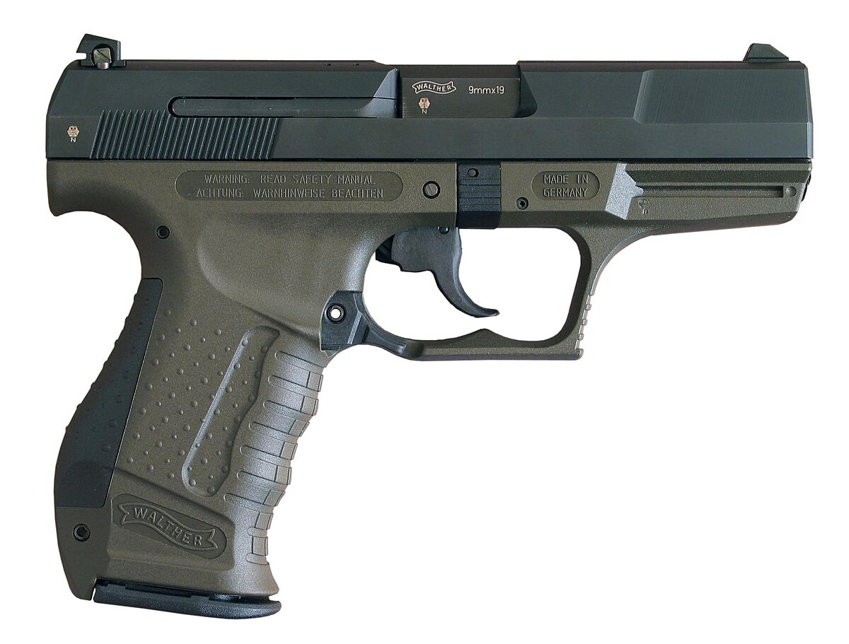
INVESTIGATIONS INTO THE SEMANTICS OF PRIVATIVE ADJECTIVES
IS THAT GUN REAL OR FAKE?
INTERN: AHANA CHATTOPADHYAY
SUPERVISOR: PHILIPPE DE GROOTE
Sémagramme team, LORIA
Master’s Thesis Defense
28/08/2025
Notes:
NOTE:
To change the image on this slide, select the picture and delete it. Then click the Pictures icon in the placeholder to insert your own image.

Slide 2
LIST OF CONTENT
.
Previous work done by Guerrini (2024)^{[1]} and by de Groote and Bernard (2024)^{[2]}
Abstract Categorial Grammar (ACG) and ACG Toolkit (ACGtk)^{[3]}
Grammar conversion and proposal of a novel entry for “fake”
[1] Guerrini, Janek. “Keeping Fake Simple”. Journal of Semantics, vol. 41, no.2, 26 Aug 2024, pp.175-210, https://doi.org/10.1093/jos/ffae010.
[2] de Groote, Philippe, and Timothée Bernard. “Perspective on individuals”. Sinn und Bedeutung 29, Noto, Italy, Sept. 2024, https://hal.science/hal-04901118.
[3] Guillaume, Maxime, Sylvain Pogodalla, and Vincent Tourneur. “ACGtk: A Toolkit for Developing and Running Abstract Categorical Grammars.” Functional and Logic Programming: 17th International Synopsium, FLOPS 2024, edited by Geremy Gibbons and Dale Miller, Springer, 2024, pp.13-30, https://doi.org/10.1007/978-981-97-2300-3_2

Slide 3
Types of Adjectives
intersective
subsective
non-subsective
privative
modal
ex: french
ex: graceful
ex: alleged
ex: fake

Slide 4
Guerrini’s PROPOSAL FOR “FAKE”

Slide 5
A PRIMARY ACCOUNT FOR FAKE
In regards to similarity and negation:
Corresponding Interpretation:
fake
𝑥 is (intended to be) similar in appearance to an instance of category
fake
𝑥 is not a real instance of the said category
fake = 𝜆𝑃.𝜆𝑥. INTENDED(𝑥, SEEM-LIKE(𝑥, 𝑃)) ∧ ￢𝑃(𝑥)

Slide 6
FAKE FAKE GUN
FAKE FAKE GUN; GUN
FAKE FAKE GUN; NOT A GUN
A cake that was built to resemble a famous model of a toy gun.
An airsoft gun made to shoot actual bullets and kill in an airsoft game.

Slide 7

ITERATION OF FAKE
something is a fake fake gun iff
it is a gun, or wasn’t made to look like a gun, or both
and moreover, it was made to look like a fake gun

Slide 8
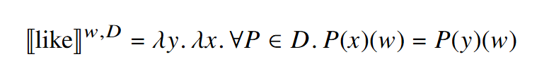


SIMILARITY IN FAKE
where given a set of relevant properties D if x and y share some common properties, then x is like y
at all worlds compatible with the visual experience of the judge 𝑗 at 𝑤, Ukranian(Olga) holds

Slide 9
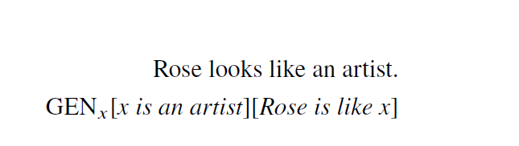
GENERIC QUANTIFIER
we can have a GENERAL reading for sentence on the right where the sense introduced doesn’t necessarily refer to a specific artist but also doesn’t indicate that she looks like all the artists in the world.

Slide 10
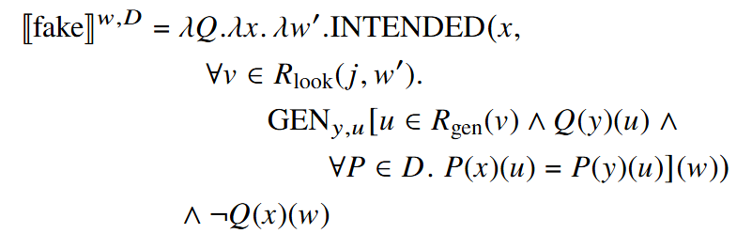
FINAL LEXICAL ENTRY FOR “FAKE” PROPOSED BY GUERRINI
𝑥 is intended in 𝑤 so that
at all worlds 𝑣 compatible with the experience of 𝑗 in 𝑤,
𝑥 shares relevant properties 𝑃 with typical instances 𝑦 of 𝑄,
and 𝑥 is not a 𝑄 in 𝑤.

Slide 11
PERSPECTIVE SEMANTICS

Slide 12
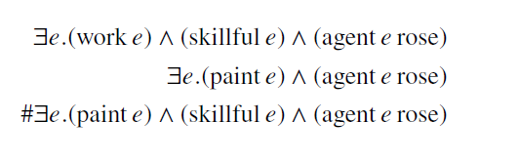
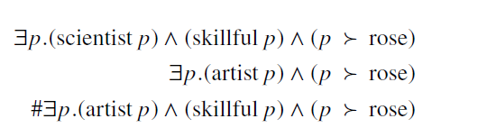
EVENT SEMANTICS AND PERSPECTIVE SEMANTICS
EVENT SEMANTICS
PERSPECTIVE SEMANTICS
Rose works skillfully.
Rose paints.
#Rose paints skillfully.
Rose is a skilled scientist.
Rose is an artist.
#Rose is a skilled artist.

Slide 13
INTRODUCTION TO PERSPECTIVE SEMANTICS
Inspired by neo-Davidsonian approach of adverbial modification, de Groote and Bernard proposes a similar approach for adnominal modification. They introduce a notion of perspective with a relation ≻ between perspectives (type p) and individuals (type e).
For the intersective adjectives, they introduce a unique function ↓ where ↓p is the individual on which perspective p is.
Rose is an American scientist.

Slide 14
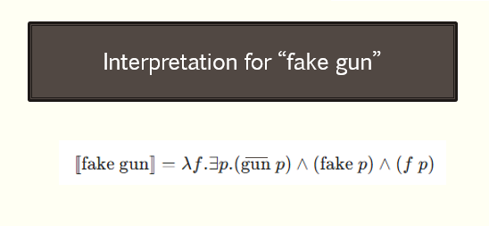

FAKE AND GUN WITH PERSPECTIVE
Interpretation for “gun”
Here, gun refers to the coerced version of gun.

Slide 15
ABSTRACT CATEGORIAL GRAMMAR (ACG)

Slide 16
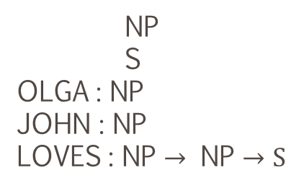


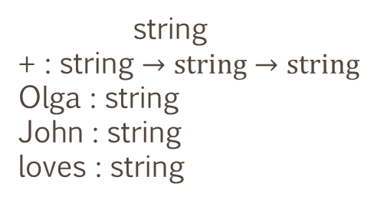

EXAMPLE OF A SIMPLE ACG
$Σ$_{syntax}
$ℒ$_{surface_form}
NP := string
S := string
OLGA := Olga
JOHN := John
LOVES := loves
LOVES JOHN OLGA := Olga + loves + John
NP
S
OLGA : NP
JOHN : NP
LOVES : NP $→$ NP $→S$
$Σ$_{string}
string
+ : string $→string→string$
Olga : string
John : string
loves : string

Slide 17
What is ACGtk?
The ACG toolkit (ACGtk) provides a compiler (acgc) that
checks and transforms Abstract Categorical Grammars (ACGs) into
suitable representations
used for testing and parsing in the
ACG interpreter
implemented in OCaml and distributed under a free license

Slide 18
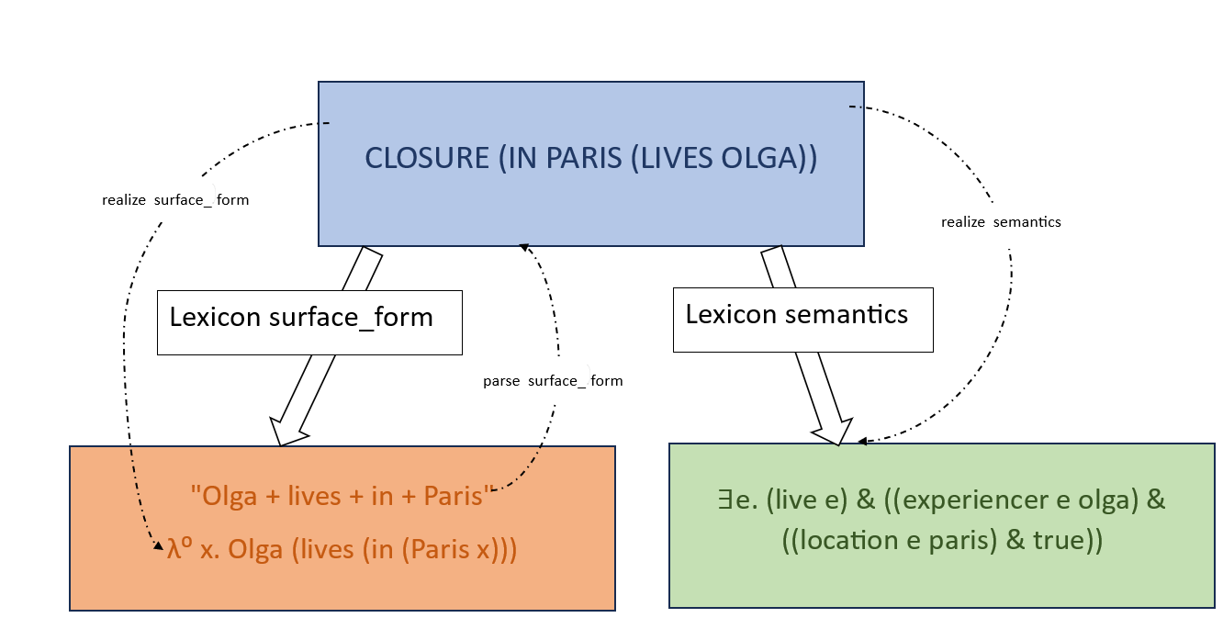

ACCESSING LEXICONS THROUGH COMMANDS
$ΣS$_{yntax}
$$ΣString$$
$$ΣLogic$$

Slide 19
Grammar conversion

Slide 20
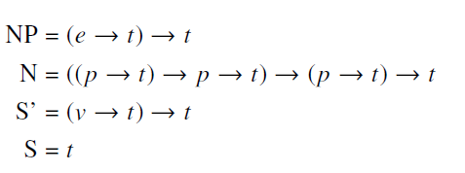
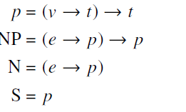
Change of type
Original type
New type
where 𝑒 is the type of entities; 𝑡 is the type of truth values; 𝑝 is the type of perspectives; 𝑣 is the type of events.
where 𝑒 is the type of entities; 𝑡 is the type of truth values; 𝑣 is the type of eventualities.

Slide 21
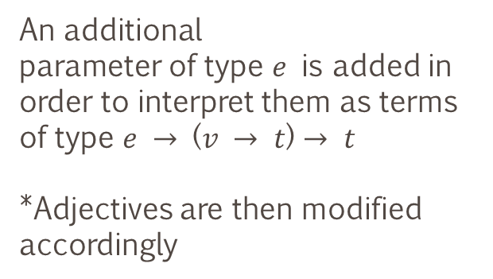
Modification in the semantic interpretation
Common noun
Noun phrase
An additional
parameter of type 𝑒 is added in order to interpret them as terms of type 𝑒 $→$ (𝑣 $→$ 𝑡) $→$ 𝑡
*Adjectives are then modified accordingly
A new variable 𝑤 is added to signify a world 𝑤 and an eventuality 𝑒 is added. This 𝑒 is an eventuality on the individual 𝑥 and (w e) means that 𝑒 is a member of 𝑤. Finally, 𝑃 is applied to both 𝑥 and 𝑤 to signify the property 𝑃 holds for 𝑥 at world 𝑤.
Determiners
Prepositions
Simpler semantic interpretations conforming to Montague semantics is used, with the added representing possible worlds 𝑤.
Only 𝑤 is added to signify the presence of
possible worlds.

Slide 22
Modification in the semantic interpretation
 | Original | Modified
C Common noun
Adjectives
NoNoun phrase
Determiners
PrePrepositions

Slide 23
Novel entry for “fake”

Slide 24
Key elements behind a FAKE N:
the property of being a N,
Representative entities which share that property and are truly Ns,
another entity that is intended to imitate the previous entities but is not a N.

Slide 25

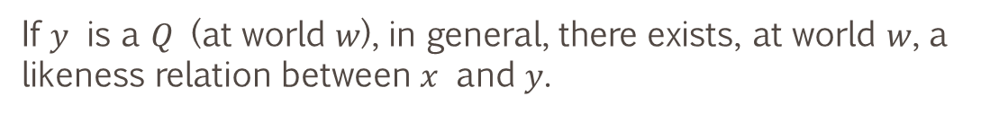
SEMANTIC INTERPRETATION FOR FAKE
$x$is intended to look like in a world 𝑤 but is not a Q in 𝑤
$Q$
If $y$ is a $Q$ (at world 𝑤), in general, there exists, at world 𝑤, a likeness relation between $x$ and $y$.

Slide 26
ITERATION OF “FAKE”

Slide 27
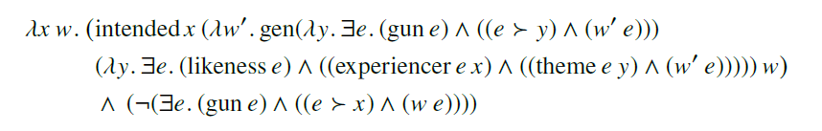
SEMANTIC INTERPRETATION FOR FAKE
A fake gun $x$ is an entity that is intended to look like a gun but that is not a gun (on which there is no gun perspective).

Slide 28
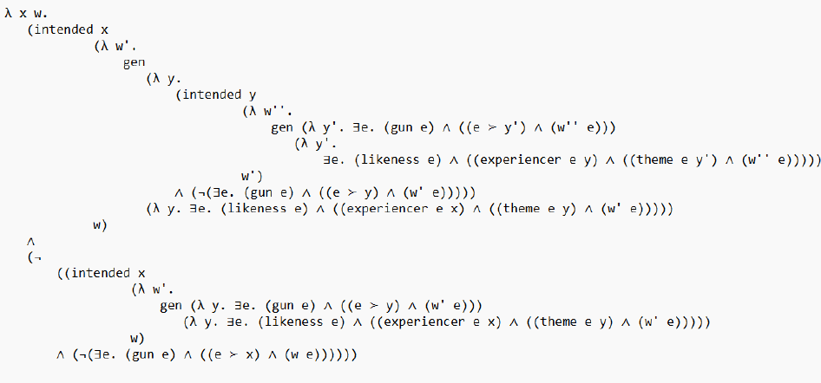
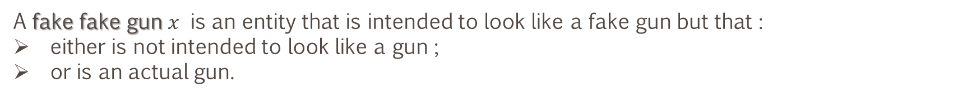
SEMANTIC INTERPRETATION FOR FAKE
A fake fake gun $x$ is an entity that is intended to look like a fake gun but that :
either is not intended to look like a gun ;
or is an actual gun.

Slide 29
That gun is fake (as a Colt).

Slide 30
